Slide 1
PRODUCT METRICS

Slide 2
Software Quality
Software quality is
- conformance to explicitly stated functional and performance requirements,
- explicitly documented development standard, and
- implicit characteristics that are expected of all professionally developed software.
Software quality is complex mix of factors that will vary across different applications and the customers who request them.

Slide 3
McCall’s Triangle of Quality
M
a
i
n
t
a
i
n
a
b
i
l
i
t
y
M
a
i
n
t
a
i
n
a
b
i
l
i
t
y
P
o
r
t
a
b
i
l
i
t
y
P
o
r
t
a
b
i
l
i
t
y
F
l
e
x
i
b
i
l
i
t
y
F
l
e
x
i
b
i
l
i
t
y
R
e
u
s
a
b
i
l
i
t
y
R
e
u
s
a
b
i
l
i
t
y
T
e
s
t
a
b
i
l
i
t
y
T
e
s
t
a
b
i
l
i
t
y
I
n
t
e
r
o
p
e
r
a
b
i
l
i
t
y
I
n
t
e
r
o
p
e
r
a
b
i
l
i
t
y
P
R
O
D
U
C
T
R
E
V
I
S
I
O
N
P
R
O
D
U
C
T
R
E
V
I
S
I
O
N
P
R
O
D
U
C
T
T
R
A
N
S
I
T
I
O
N
P
R
O
D
U
C
T
T
R
A
N
S
I
T
I
O
N
P
R
O
D
U
C
T
O
P
E
R
A
T
I
O
N
P
R
O
D
U
C
T
O
P
E
R
A
T
I
O
N
C
o
r
r
e
c
t
n
e
s
s
C
o
r
r
e
c
t
n
e
s
s
U
s
a
b
i
l
i
t
y
U
s
a
b
i
l
i
t
y
E
f
f
i
c
i
e
n
c
y
E
f
f
i
c
i
e
n
c
y
I
n
t
e
g
r
i
t
y
R
e
l
i
a
b
i
l
i
t
y
I
n
t
e
g
r
i
t
y
R
e
l
i
a
b
i
l
i
t
y

Slide 4
A Comment
McCall’s quality factors were proposed in the early 1970s. They are as valid today as they were in that time. It’s likely that software built to conform to these factors will exhibit high quality well into the 21st century, even if there are dramatic changes in technology.

Slide 5
Measures, Metrics and Indicators
A measure provides a quantitative indication of the extent, amount, dimension, capacity, or size of some attribute of a product or process
The IEEE glossary defines a metric as “a quantitative measure of the degree to which a system, component, or process possesses a given attribute.”
An indicator is a metric or combination of metrics that provide insight into the software process, a software project, or the product itself

Slide 6
Measurement Principles
The objectives of measurement should be established before data collection begins;
Each technical metric should be defined in an unambiguous manner;
Metrics should be derived based on a theory that is valid for the domain of application (e.g., metrics for design should draw upon basic design concepts and principles and attempt to provide an indication of the presence of an attribute that is deemed desirable);
Metrics should be tailored to best accommodate specific products and processes [Bas84]

Slide 7
Measurement Process
Formulation. The derivation of software measures and metrics appropriate for the representation of the software that is being considered.
Collection. The mechanism used to accumulate data required to derive the formulated metrics.
Analysis. The computation of metrics and the application of mathematical tools.
Interpretation. The evaluation of metrics results in an effort to gain insight into the quality of the representation.
Feedback. Recommendations derived from the interpretation of product metrics transmitted to the software team.

Slide 8
Goal-Oriented Software Measurement
The Goal/Question/Metric Paradigm
  (1) establish an explicit measurement goal that is specific to the process activity or product characteristic that is to be assessed
  (2) define a set of questions that must be answered in order to achieve the goal, and
  (3) identify well-formulated metrics that help to answer these questions.
Goal definition template
  Analyze {the name of activity or attribute to be measured}
  for the purpose of {the overall objective of the analysis}
  with respect to {the aspect of the activity or attribute that is considered}
  from the viewpoint of {the people who have an interest in the measurement}
  in the context of {the environment in which the measurement takes place}.

Slide 9
Metrics Attributes
Simple and computable. It should be relatively easy to learn how to derive the metric, and its computation should not demand inordinate effort or time
Empirically and intuitively persuasive. The metric should satisfy the engineer’s intuitive notions about the product attribute under consideration
Consistent and objective. The metric should always yield results that are unambiguous.
Consistent in its use of units and dimensions. The mathematical computation of the metric should use measures that do not lead to bizarre combinations of unit.
Programming language independent. Metrics should be based on the analysis model, the design model, or the structure of the program itself.
Effective mechanism for quality feedback. That is, the metric should provide a software engineer with information that can lead to a higher quality end product

Slide 10
Collection and Analysis Principles
Whenever possible, data collection and analysis should be automated;
Valid statistical techniques should be applied to establish relationship between internal product attributes and external quality characteristics
Interpretative guidelines and recommendations should be established for each metric

Slide 11
Function-Based Metrics
The function point metric (FP), first proposed by Albrecht [ALB79], can be used effectively as a means for measuring the functionality delivered by a system.
FP can be used to (a) estimate the cost or effort required to design, code, and test the software; (b) predict the number of errors that will be encountered during testing, and (c) forecast the number of components and / or the number of projected source lines in the implemented systems.
Function points are derived using an empirical relationship based on countable (direct) measures of software's information domain and assessments of software complexity
Information domain values are defined in the following manner:
  number of external inputs (EIs)
  number of external outputs (EOs)
  number of external inquiries (EQs)
  number of internal logical files (ILFs)
  Number of external interface files (EIFs)

Slide 12
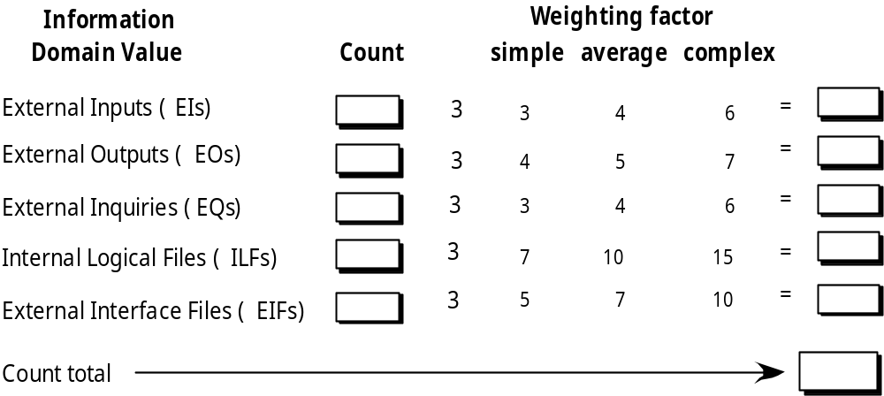
Function Points

Slide 13
Function Point
Please go through the page number 472 – 475 to read the details of FP

Slide 14
Maintenance Metrics
IEEE Std. 982.1-1988 suggests a software maturity index (SMI) that provides an indication of the stability of a software product (based on changes that occur for each release of the product). The following information is determined:
    M_{T} = the number of modules in the current release
    F_{c} = the number of modules in the current release that have been changed
    F_{a} = the number of modules in the current release that have been added
    F_{d} = the number of modules from the preceding release that were deleted in the current release
The software maturity index is computed in the following manner:
    SMI = [M_{T} - (F_{a} + F_{c} + F_{d})]/M_{T}
As SMI approaches 1.0, the product begins to stabilize.
SMI can also be used as a metric for planning software maintenance activities.

